Slide 1
Apologetics- Natural Revelation-Human Body
Tri-Cities
December 9, 2024

Slide 2
Outline
Introduction
Existence of God/Evidence in Other Cultures
Natural Revelation
Natural Revelation- Medicine
Did Jesus Live
What did Jesus Claim

Slide 3
Theme Text: Rom 1:20
“For since the creation of the world His invisible attributes, His eternal power and divine nature, have been clearly seen, being understood through what has been made…” (NAS)
Since the nature of God can be understood by examining the Creation, employing the tools of science can give us a better understanding of His creation and our place in it.

Slide 4
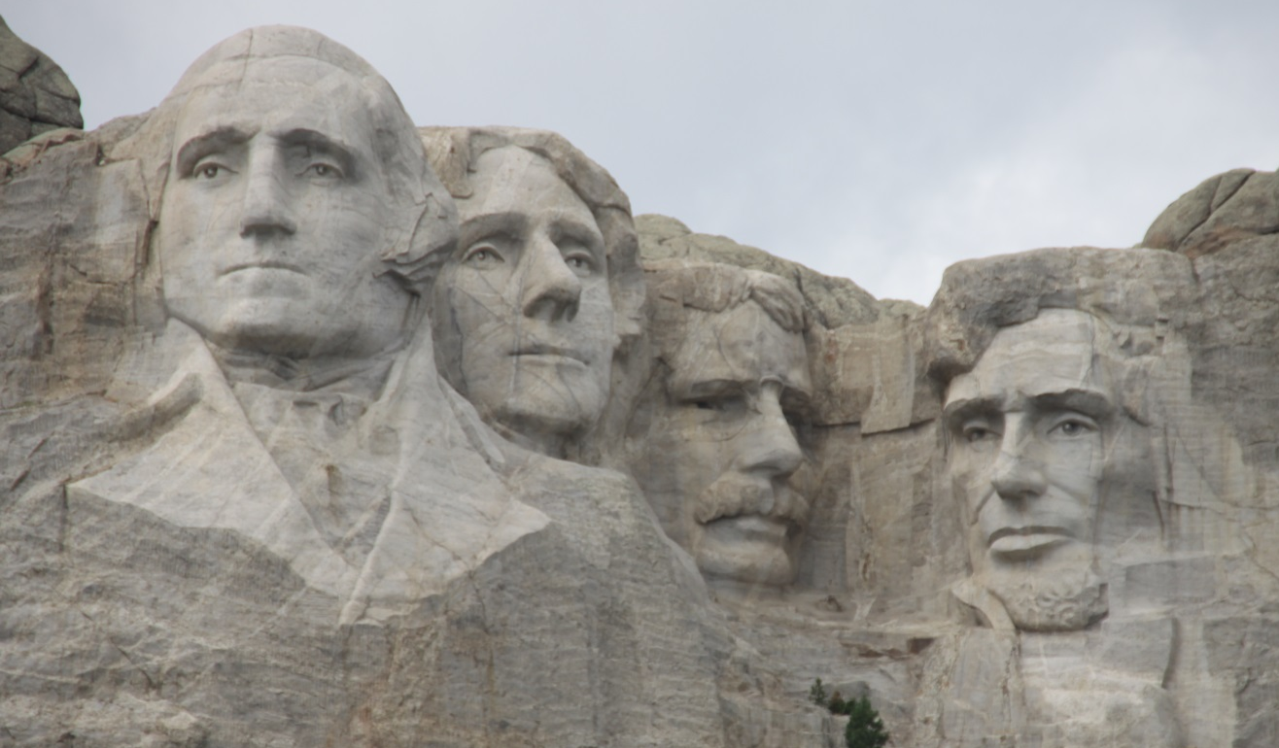
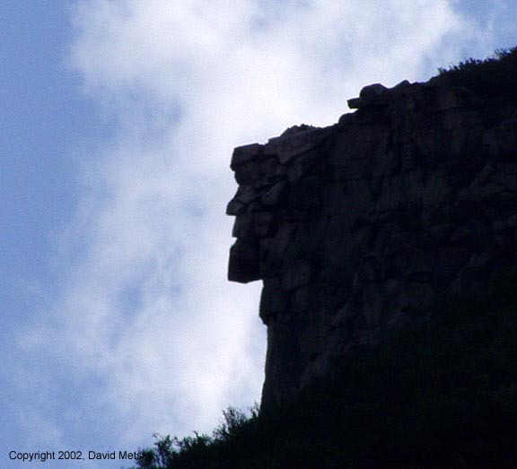
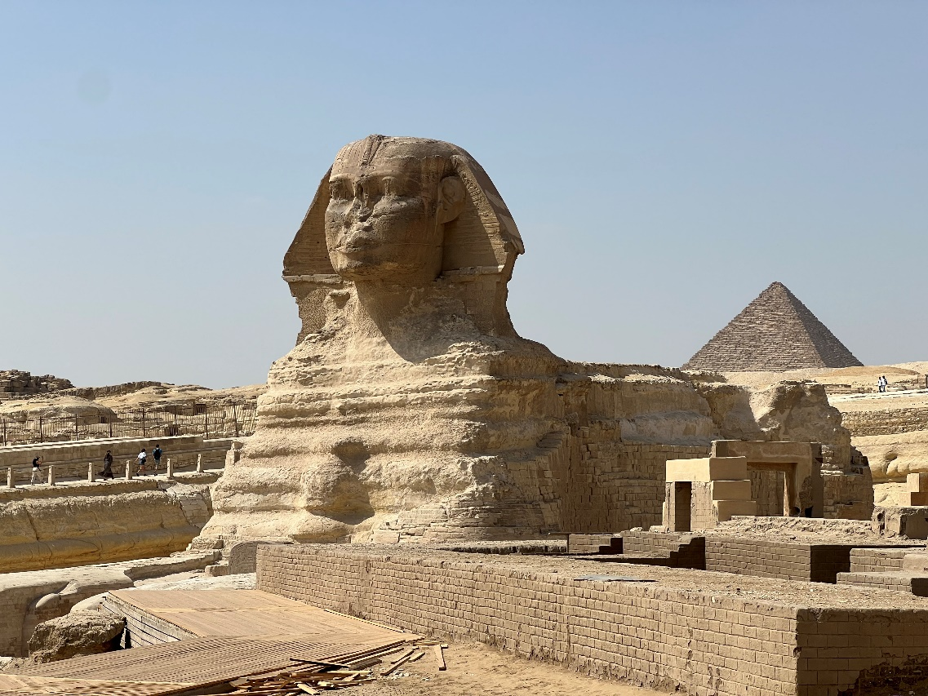
CDK
CDK

Slide 5
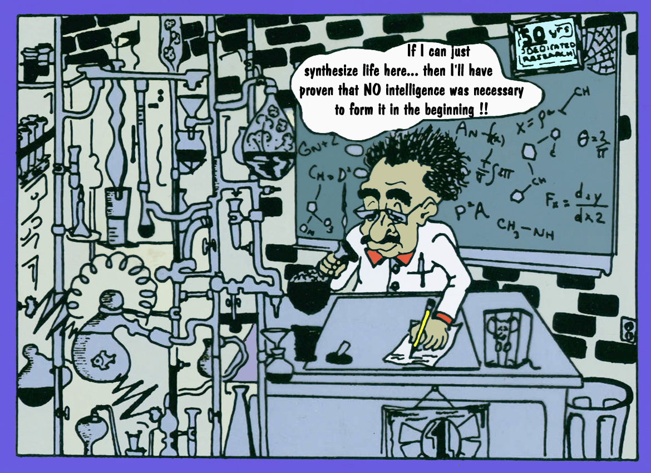
Cara Santa Maria

Slide 6
Assumptions of Evolutionary Theory
There are many variations of the Theory of Biological Evolution
Basic tenets of all:
Life originated by spontaneous generation from non-living compounds.
One-celled life became multi-celled life.
Plant and animal life became separate, although related.
Animal life gradually became more and more complex, from protozoa to invertebrates to vertebrates to fish to reptiles to mammals to man.
Slow change is required. “Anything can happen, given enough time.”
Change occurs by two mechanisms:
Natural Selection: Environment causes imperceptible change in physical structure & it is passed to offspring.
Mutation: Sudden change from an external source. (e.g. radiation)

Slide 7
Dialectic Materialistic Scheme for the Origin of Life
Premise: On its own, matter organized, combined and became living.
Inorganics
Inorganics
Examples:
Carbon C
Oxygen O
Iron Fe
Water H2O

Slide 8
Dialectic Materialistic Scheme for the Origin of Life
Premise: On its own, matter organized, combined and became living.
Organics
Inorganics
Organics
Inorganics
Examples:
Carbon C
Oxygen O
Iron Fe
Water H2O
Methane
Carbon
Dioxide
Alcohols
~2-8

Slide 9
Dialectic Materialistic Scheme for the Origin of Life
Premise: On its own, matter organized, combined and became living.
Organics
Inorganics
Bio-Organics
Organics
Inorganics
Bio-Organics
Examples:
Carbon C
Oxygen O
Iron Fe
Water H2O
Methane
Carbon
Dioxide
Alcohols
Amino Acids
Sugars
Carbo-
hydrates
~2-8 ~5

Slide 10
Dialectic Materialistic Scheme for the Origin of Life
Premise: On its own, matter organized, combined and became living.
Organics
Inorganics
Bio-Organics
Organics
Bio-Polymers
Inorganics
Bio-Organics
Bio-Polymers
Examples:
Carbon C
Oxygen O
Iron Fe
Water H2O
Methane
Carbon
Dioxide
Alcohols
Amino Acids
Sugars
Carbo-
hydrates
Proteins
Nucleotides
~2-8 ~5 ~12

Slide 11
Dialectic Materialistic Scheme for the Origin of Life
Premise: On its own, matter organized, combined and became living.
Organics
Bio-Polymers
Bio-Organics
Macromolecules
Inorganics
Organics
Bio-Polymers
Inorganics
Bio-Organics
Macromolecules
Bio-Polymers
Examples:
Carbon C
Oxygen O
Iron Fe
Water H2O
Methane
Carbon
Dioxide
Alcohols
Amino Acids
Sugars
Carbo-
hydrates
Proteins
Nucleotides
Polynucleo-
tides
Nucleic Acids
(RNA & DNA)
~2-8 ~5 ~12 ~1200

Slide 12
Dialectic Materialistic Scheme for the Origin of Life
Premise: On its own, matter organized, combined and became living.
Organics
Bio-Polymers
Bio-Organics
Macromolecules
Inorganics
Bio-Polymers
Living Cell
Organics
Inorganics
Bio-Organics
Macromolecules
Bio-Polymers
Examples:
Carbon C
Oxygen O
Iron Fe
Water H2O
Methane
Carbon
Dioxide
Alcohols
Amino Acids
Sugars
Carbo-
hydrates
Proteins
Nucleotides
Polynucleo-
tides
Nucleic Acids
(RNA & DNA)
PPLO
Bacteria
Protozoa
?
~2-8 ~5 ~12 ~1200 100’s

Slide 13
Gil Bremseth

Slide 14
Swiss physicist Charles Guye once estimated the probability of the random chance formation of a single simple protein of molecular weight 20,000 (too simple for life) and consisting of only 2 elements (compared to the usual 4 to 10) as such that if it had 500 trillion chances per second for any two of its components to randomly combine, it would take the number of years expressed by a 10 followed by 242 zeros to occur. (i.e. an impossibility!)
Dr. S. Pelletier, a University of Georgia chemist, has said that the initial chance formation of two or three protein molecules is "equivalent to admitting a miracle."

Slide 15
“If it could be demonstrated that any complex organ existed which could not possibly have been formed by numerous successive, slight modifications, my theory would absolutely break down. But I can find no such case.”
Charles Darwin
The Origin of the Species

Slide 16
A quote from the Introduction to the Centennial Edition of Charles Darwin’s “Origin of Species:”
“As we know, there is a great divergence of opinion among biologists, not only about the causes of evolution but even about the actual process. This divergence exists because the evidence is unsatisfactory and does not permit any certain conclusion. It is therefore right and proper to draw the attention of the non-scientific public to the disagreements about evolution. But some recent remarks of evolutionists show that they think this unreasonable. This situation, where scientific men rally to the defence of a doctrine they are unable to define scientifically, much less demonstrate with scientific rigour, attempting to maintain its credit with the public by the suppression of criticism and the elimination of difficulties, is abnormal and undesirable in science."
W.R. Thompson, R.F.S., Director
Institute of Biological Control, Ottawa, Canada
"Introduction to Darwin's Theory"
Charles Darwin: ORIGIN OF SPECIES
Dent Publishers, London, 1967

Slide 17
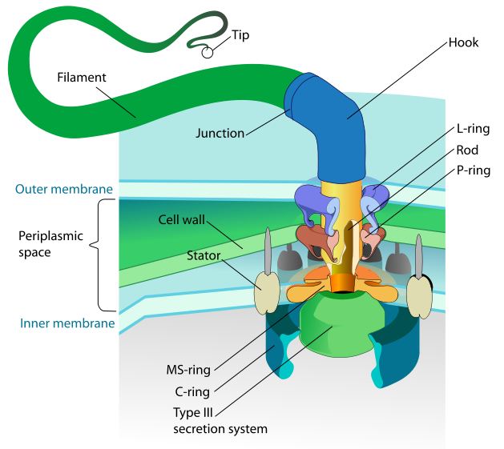
Irreducible Complexity
A single system which is composed of several interacting parts that contribute to the basic function, and where the removal of any one of the basic parts causes the system to effectively cease functioning. Michael Behe
Galen
1-2 Century AD
Wikipedia
ros.alexisleon.com

Slide 18
Specified Complexity
A single letter is specific
A long sentence of random letters is complex but not specific
A Shakespearean sonnet is both complex and specific

Slide 19
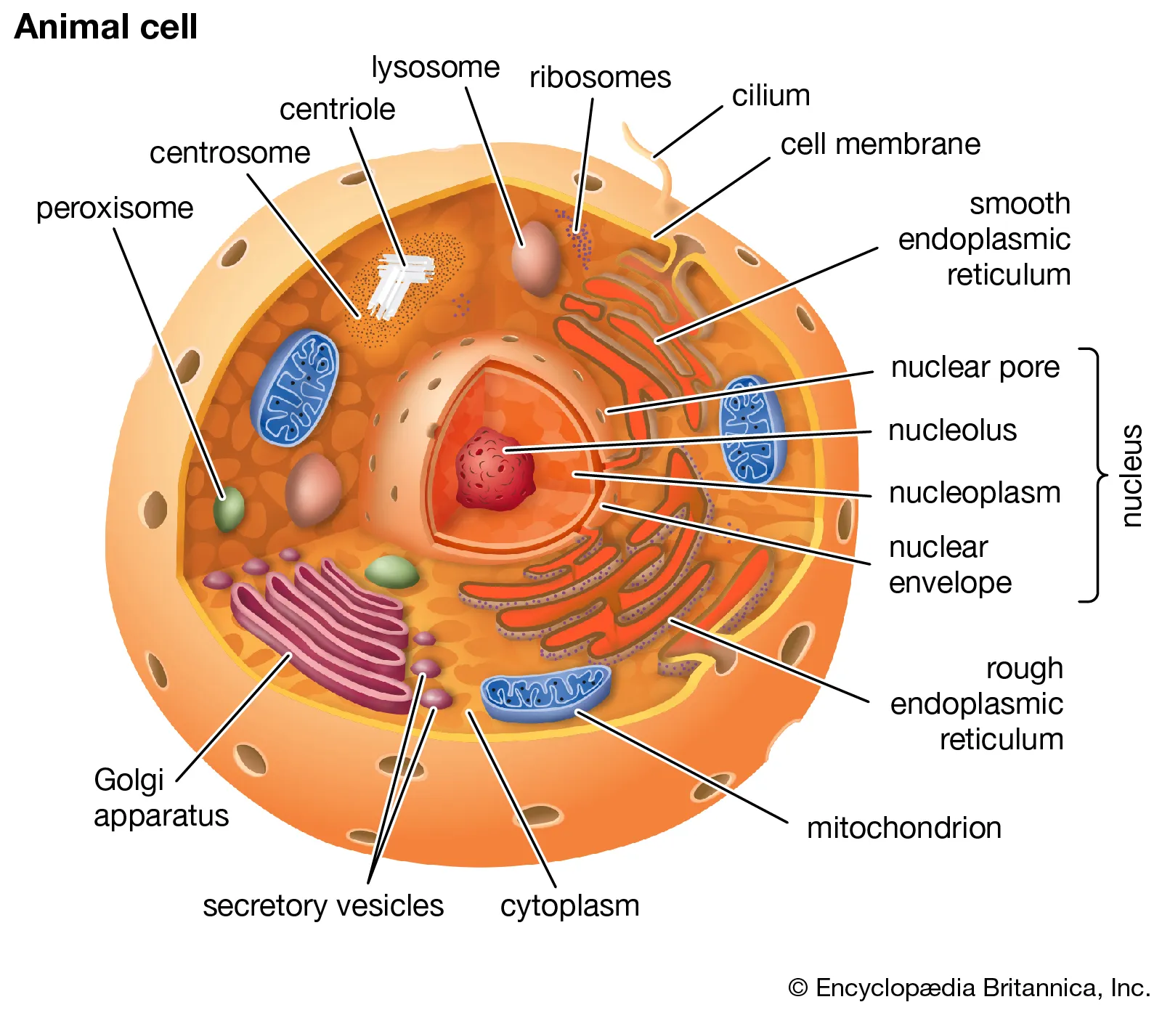

Slide 20
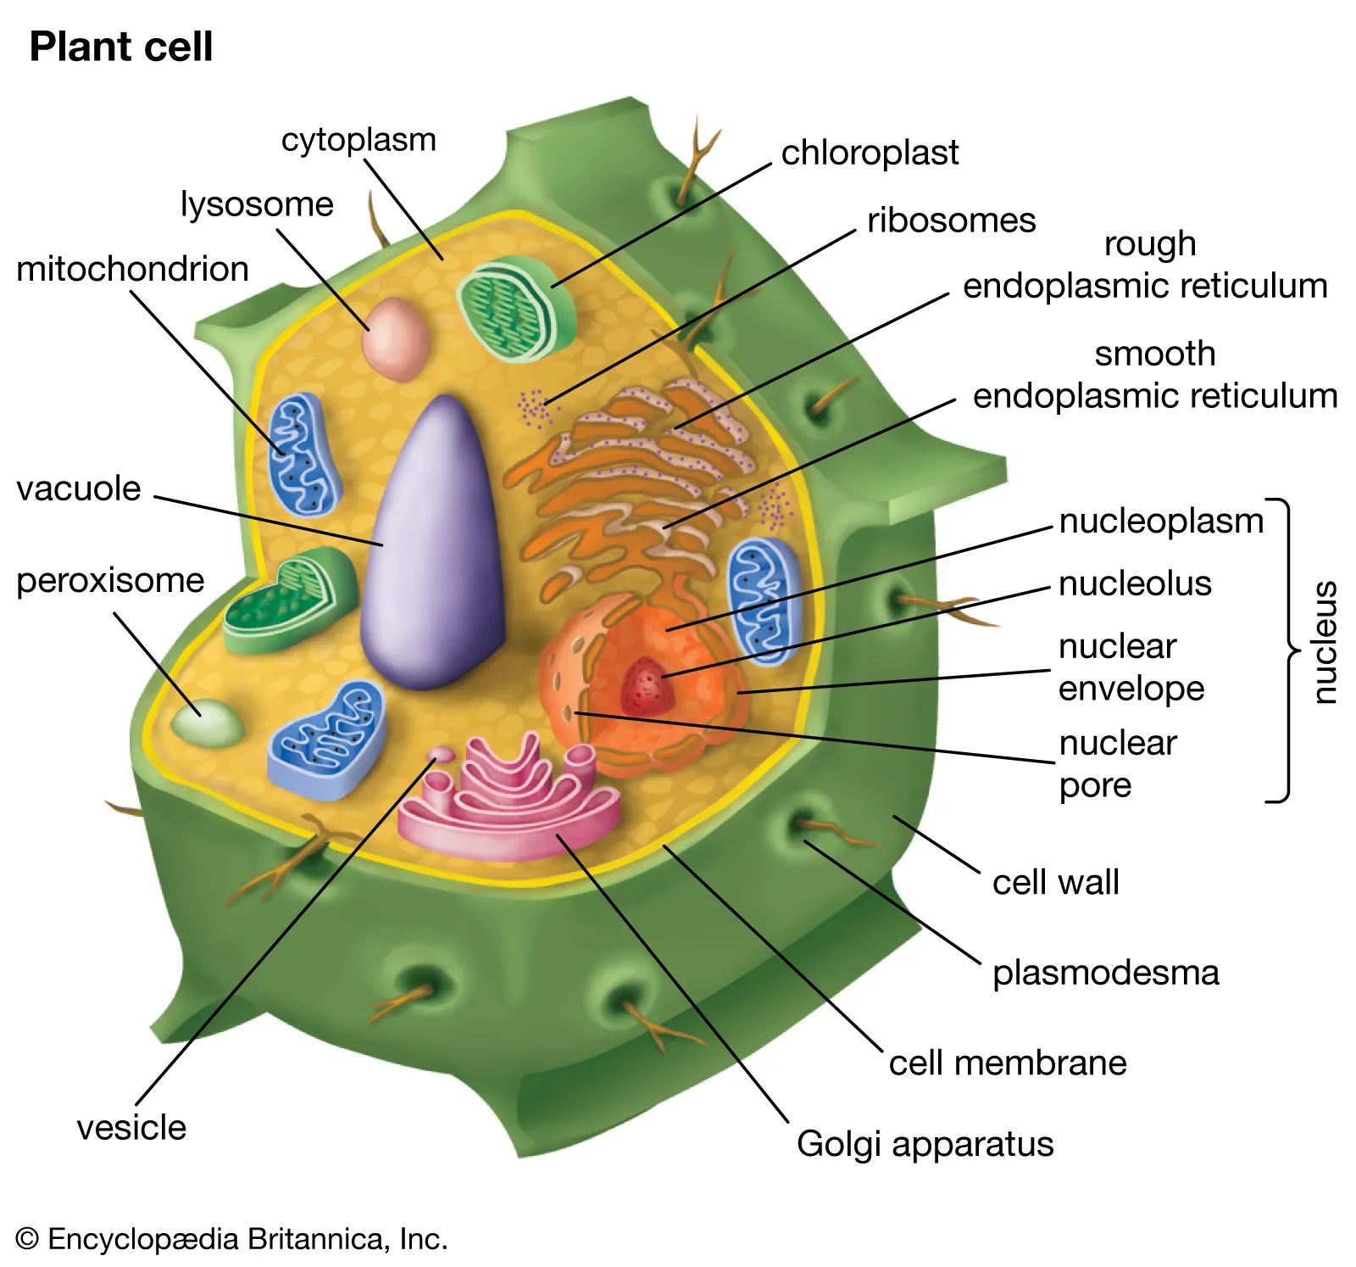

Slide 21
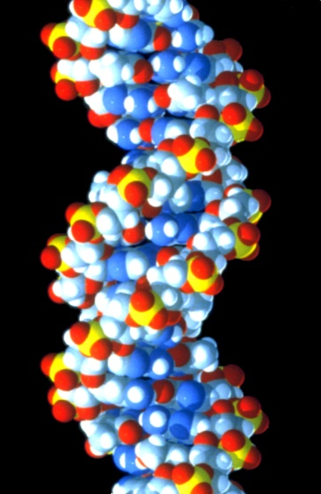
pdmclerran@yahoo

Slide 22
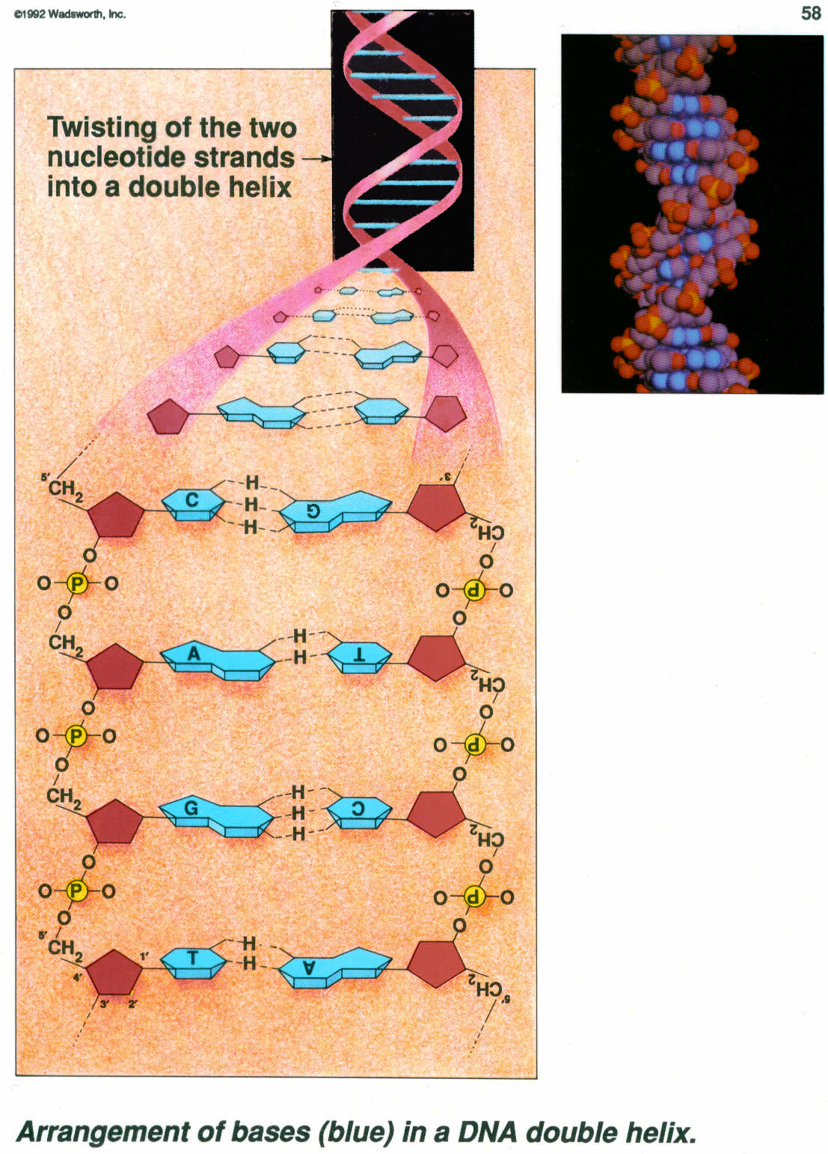
Wadsworth Publishing

Slide 23
DNA is a complex, specific language
Design on the Microscopic Level- Signature in the Cell, Part 1 &2.
June 18, 2018
http://www.gettysburgchurchofchrist.org/preacher/dr-harry-e-payne
Buddy Payne
Which came first, the DNA or the protein?

Slide 24
Evolution of sexual reproduction
Must have occurred simultaneously for the male and female
The physical, chemical and emotional systems would need to be compatible
Many intricate processes occur that would have needed a remarkable string of accidents to occur

Slide 25
Psalm 139:13-16
For You have formed my inward parts; You have covered me in my mother’s womb.
I will praise You, for I am fearfully and wonderfully made; Marvelous are Your works, And that my soul knows very well.
My frame was not hidden from You, When I was made in secret, And skillfully wrought in the lowest parts of the earth.
Your eyes saw my substance, being yet unformed. And in Your book they all were written, The days fashioned for me, When as yet there were none of them.

Slide 26
Job 10:9-11
Remember, I pray, that You have made me like clay. And will You turn me into dust again?
Did You not pour me out like milk, And curdle me like cheese,
Clothe me with skin and flesh, And knit me together with bones and sinews?

Slide 27
Female reproductive organs

Slide 28
Ovary
Quizlet.com

Slide 29
Ovary
php.med.unsw.edu.au

Slide 30
Female reproductive organs

Slide 31
Spinnbarkeit
Only during ovulation is cervical mucus able to be penetrated by sperm

Slide 32
Ovum & Sperm
Lennart Nilsson

Slide 33
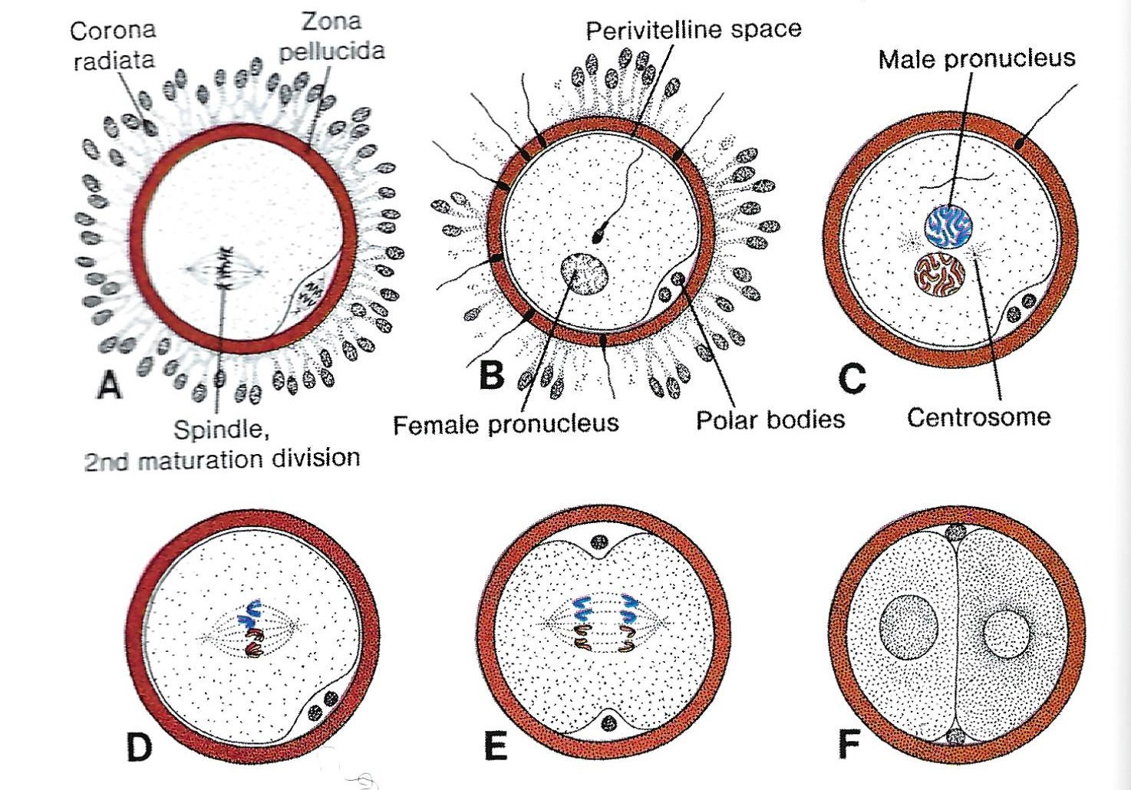
Stages of Fertilization
Langman’s Medical Embryology

Slide 34
Fertilization
Lennart Nilsson

Slide 35
Chromosomes
Rita Rosita,
Brawijaya University

Slide 36
24 Hour-2 Cell
Lennart Nilsson

Slide 37
Morula
Langman’s Medical Embryology

Slide 38
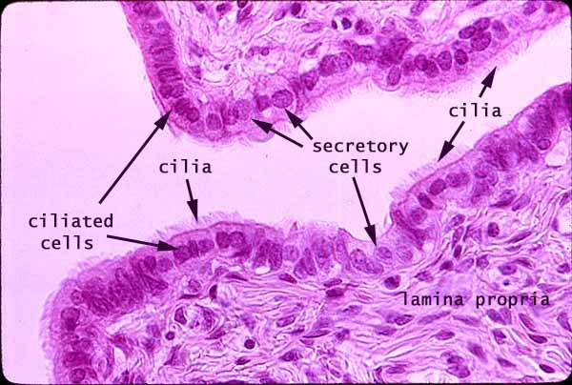
Fallopian Tubes & Metachronal Rhythm
SIUMed.edu

Slide 39
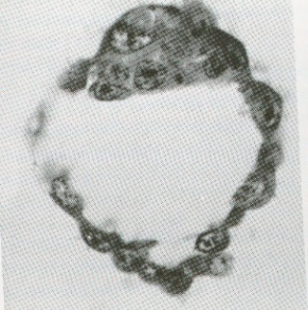
Blastocyst
Lennart Nilsson
Langman’s Medical Embryology

Slide 40
Implantation
Lennart Nilsson

Slide 41
Placenta
Ilus Medical

Slide 42
Immune Function

Slide 43
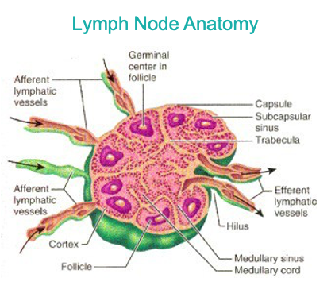
CLL Society

Slide 44
American Society for Microbiology

Slide 45
Chyng-Ru Wang, PhD, Northwestern University

Slide 46
Babraham Institute

Slide 47
Quizlet

Slide 48
Ann Allergy Asthma Immunol.

Slide 49
65 Variable Genes
27 Diversity Genes
6 Joining Genes
10,530 combinations plus more with light chains added
Dr. Rodrigo Pinto Martinez

Slide 50
Donald Doll, MD

Slide 51
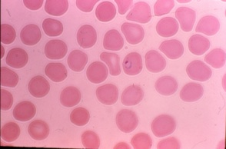
Donald Doll, MD

Slide 52
Donald Doll, MD

Slide 53
3 Week (20 Day)
Langman’s Medical Embryology

Slide 54
4 Week
Lennart Nilsson

Slide 55
5 Week
Lennart Nilsson

Slide 56
5.5 Week
Lennart Nilsson

Slide 57
6 Week
Lennart Nilsson

Slide 58
10.5 Week
Lennart Nilsson

Slide 59
32 Week (8 Month)
Lennart Nilsson

Slide 60
Pelvis
Pearson Education

Slide 61
Birth
Daphne Hsu, MD

Slide 62
Umbilical cord
Lennart Nilsson

Slide 63
Clotting
Quizlet

Slide 64
Quizlet

Slide 65
Quizlet

Slide 67
Quizlet

Slide 68
NEJM

Slide 69
Kidney
Quizlet

Slide 70
Quizlet

Slide 71
Haisook at Wikipedia

Slide 72
Mikael Haggstrom
Wikipedia

Slide 73
S. Nielson Anatomy of the Kidney

Slide 74
Quizlet

Slide 75
Journal of Clinical Investigation (Farquhar, 2006).

Slide 76
Psalm 104:24
O Lord, how many are Your works! In wisdom You have made them all. The earth is full of Your possessions.

