Slide 1
Apologetics- Did Jesus Really Live
Tri-Cities
December 10, 2024

Slide 2
Outline
Introduction
Existence of God/Evidence in Other Cultures
Natural Revelation
Natural Revelation- Medicine
Did Jesus Live
What did Jesus Claim

Slide 3
Why is This Day Necessary?
People have claimed that Jesus never lived
Many teachers and professors do not believe the accounts about Jesus are accurate
They believe there are hundreds of other accounts that are hidden but are closer to the truth, and that what we have are written hundreds of years after the fact and full of made up stories
The Jesus Seminar argues these very points and has been influential with major media

Slide 4
The Gospel Facts
Matthew 1:1 “The book of the genealogy of Jesus Christ, the Son of David, the Son of Abraham”
Mark 1:1 “The beginning of the gospel of Jesus Christ, the Son of God”
Luke 1:31 “And behold, you will conceive in your womb and bring forth a Son, and shall call His name Jesus”
John 1:36 “And looking at Jesus as He walked, he said, ‘Behold the Lamb of God !’”

Slide 5
5 Principles That Help Establish an Eyewitness Account as Credible
Multiple, independent sources
Attestation by an enemy
An embarrassing admission
Eyewitness testimony supports historical claims
Early testimony is better than later testimony

Slide 6
Dating the New Testament
Galatians: AD 49-52
1 Thessalonians: AD 51-52
Romans: AD 55-59
1 Corinthians: AD 55-59
Mark: mid-late AD 50’s
Luke: late AD 50’s, early 60’s
Matthew: AD 60’s
John: AD 80-90’s

Slide 7
1 Corinthians 15:3-8 (AD 55-59)
“For I delivered to you first of all that which I also received: that Christ died for our sins according to the Scriptures, ⁴ and that He was buried, and that He rose again the third day according to the Scriptures, ⁵ and that He was seen by Cephas, then by the twelve. ⁶ After that He was seen by over five hundred brethren at once, of whom the greater part remain to the present, but some have fallen asleep. ⁷ After that He was seen by James, then by all the apostles. ⁸ Then last of all He was seen by me also, as by one born out of due time.”

Slide 8
How Historians Establish Reliability
Textual Criticism: Documentary evidence
Do we have accurate copies of the originals?
Authorship and Dating
What are the dates of the composition and who were the authors?
Reliability of the Composition
Can the authors be relied upon to give an accurate portrayal of the events?

Slide 9
Reliability of the Composition
Can the authors be relied upon to give an accurate account of the events?
7 Tests of Reliability
Intention Test
Ability Test
Character Test
Consistency Test
Bias Test
Cover-Up Test
Corroboration Test

Slide 10
Reliability of the Composition
Intention Test – Did the author intend to preserve genuine history?
Luke 1:1-4 careful investigation
Luke 3:1-2 Luke places events into historical setting and mentions actual figures from time period
Lack of the early controversies in the gospels

Slide 11
Acts 26:26
Paul to Festus
“For the king, before whom I also speak freely, knows these things; for I am convinced that none of these things escapes his attention, since this thing was not done in a corner.”

Slide 12
1 Corinthians 15:3-8
“For I delivered to you first of all that which I also received: that Christ died for our sins according to the Scriptures, ⁴ and that He was buried, and that He rose again the third day according to the Scriptures, ⁵ and that He was seen by Cephas, then by the twelve. ⁶ After that He was seen by over five hundred brethren at once, of whom the greater part remain to the present, but some have fallen asleep. ⁷ After that He was seen by James, then by all the apostles. ⁸ Then last of all He was seen by me also, as by one born out of due time.”

Slide 13
Luke’s Precision
Sir William Ramsay (1852-1916)
Was skeptical of Luke's accuracy, but studied
Later concluded he correctly documented 32 countries, 54 cities, 9 islands, 13 ruling figures verified as historical.
“His statements of fact [are] trustworthy; he is possessed of the true historic sense.”

Slide 14
Luke’s Precision
“This means that Luke is fully trustworthy as a historian of the life of Christ. Therefore to read the third Gospel is to encounter the authentic, historical Jesus.” C. Marvin Pate

Slide 15
Reliability of the Composition
Ability Test – Were they able to preserve a reliable history?
Oral Culture – strong memorization skills
Rabbis had memorized entire Old Testament
Over 80% of Jesus teachings were in figures or Hebrew poetic form and easily memorized
Were and are flexible, freedom to paraphrase as long as the basic sense of a story was communicated

Slide 16
Reliability of the Composition
Ability Test – Were they able to preserve a reliable history?
Oral Culture – strong memorization skills
Corrective and intervening witnesses were alive

Slide 17
Reliability of the Composition
Ability Test – Were they able to preserve a reliable history?
Oral Culture – strong memorization skills
Corrective and intervening witnesses were alive
Capability of the authors:
Matthew: Tax-collector, familiar with frauds, deception, etc. and would have been scrutinizing
Luke: Physician
John: Closest to Jesus, excellent eyewitness
Mark: Close companion of Peter, also Barnabas & Paul

Slide 18
Reliability of the Composition
Character Test – Do they have integrity?
Reported teaching of Jesus that called for highest level of integrity
Blatantly honest about their own failings
Nothing to gain from their testimony

Slide 19
“They had nothing to gain except criticism, ostracism, and martyrdom. They certainly had nothing to win financially. If anything this would have provided pressure to keep quiet, to deny Jesus, to downplay him, even to forget they ever met him– yet because of their integrity, they proclaimed what they saw, even when it meant suffering and death.” Craig Blomberg quoted in The Case for Christ

Slide 20
Reliability of the Composition
Consistency Test – Do the authors contradict one another?
Ancient standards of writing allowed for paraphrase
If they had been identical there would have been a charge of conspiracy
Contradictions are explicable

Slide 21
Reliability of the Composition
Bias Test – Do the authors have a vested interest?
They were persecuted
They were ostracized from their community
Almost all the apostles were put to death

Slide 22
Apostles’ “Good Fortune”
Peter- crucified upside down by Nero in the 60’s
Andrew- crucified in Patras, Achaea, Greece
James- beheaded in AD36 by Agrippa I
John- exiled and died at age 95
Philip- stoned and crucified in Hierapolis, Phrygia
Thomas- killed in Chennai (Madras), India
Matthew- killed with a spear

Slide 23
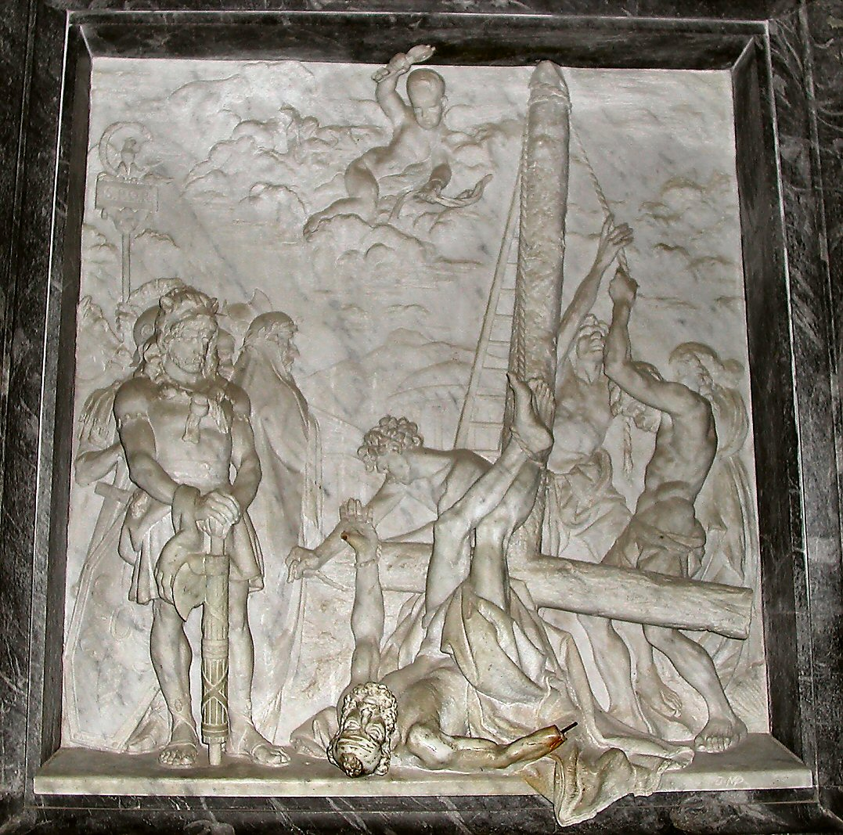
Peter crucified upside down, Church of Three Fountains
BiblePlaces.com
Peter crucified upside down, Church of Three Fountains

Slide 24
Apostles’ “Good Fortune”
Bartholomew- Flayed alive and crucified upside down in Armenia
James son of Alphaeus (the less)- crucified in Ostrakine in Lower Egypt
Simon (the zealot)- preached in Armenia and/or Britain and died there
Thaddeus- martyred in Persia or Beirut
Paul- Was beheaded in Rome

Slide 25
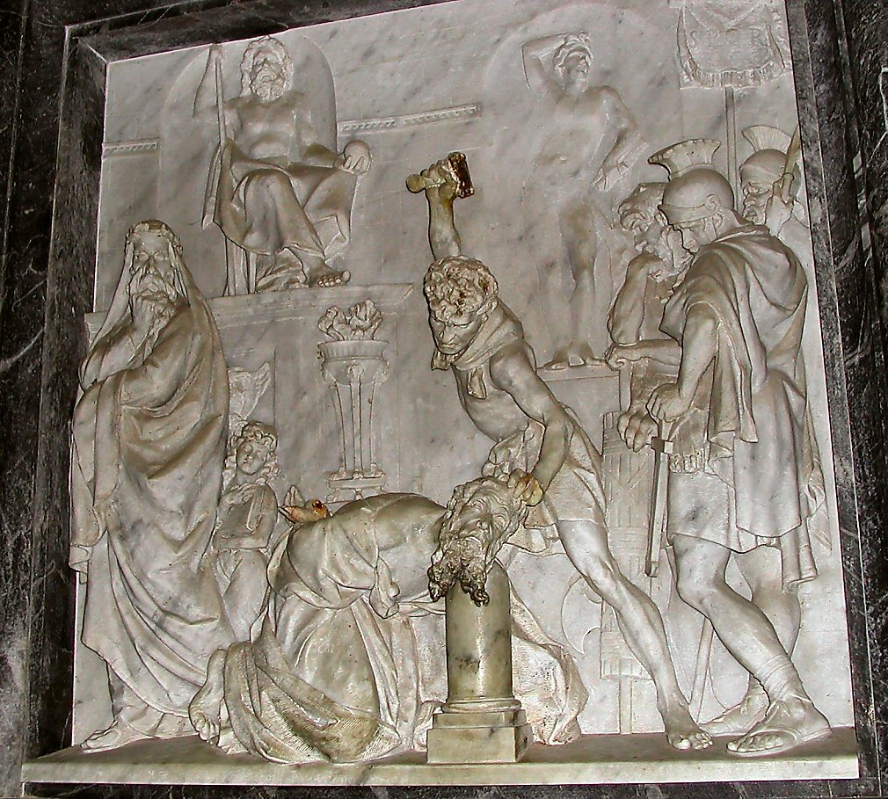
Paul's beheading carving, Church of Three Fountains
BiblePlaces.com
Paul's beheading carving, Church of Three Fountains

Slide 26
Reliability of the Composition
Cover-Up Test – Do the authors exclude negative details?
“Their want of faith in their master, their dullness of apprehension of his teachings, their strivings for pre-eminence, their inclination to call fire from heaven upon their enemies, their desertion of their Lord in his hour of extreme peril; these and many other incidents tended directly to their own dishonor.”
Simon Greenleaf, Testimony of the Evangelists

Slide 27
Reliability of the Composition
Corroboration Test – Do outside sources corroborate?
“Within 100 to 150 years after the birth of Christ, approximately eighteen non-Christian, extra-biblical sources from secular history … mention more than one hundred facts, beliefs, and teachings from the life of Christ… including miracles, the resurrection, and his claims to be deity.”
Gary Habermas, Liberty University

Slide 28
Luke 3:1-2 Historical events, geographical places and political positions
“In the fifteenth year of the reign of Tiberius Caesar, Pontius Pilate being governor of Judea, and Herod being tetrarch of Galilee, and his brother Philip tetrarch of the region of Ituraea and Trachonitis, and Lysanias tetrarch of Abilene, during the high priesthood of Annas and Caiaphas, the word of God came to John the son of Zechariah in the wilderness”

Slide 29
Luke 3:1-2 Historical events, geographical places and political positions
“In the fifteenth year (1)

Slide 30
Luke 3:1-2 Historical events, geographical places and political positions
“In the fifteenth year of the reign of Tiberius Caesar (2),

Slide 31
Luke 3:1-2 Historical events, geographical places and political positions
“In the fifteenth year of the reign of Tiberius Caesar, Pontius Pilate (3)

Slide 32
Luke 3:1-2 Historical events, geographical places and political positions
“In the fifteenth year of the reign of Tiberius Caesar, Pontius Pilate being governor (4)

Slide 33
Luke 3:1-2 Historical events, geographical places and political positions
“In the fifteenth year of the reign of Tiberius Caesar, Pontius Pilate being governor of Judea (5)

Slide 34
Luke 3:1-2 Historical events, geographical places and political positions
“In the fifteenth year of the reign of Tiberius Caesar, Pontius Pilate being governor of Judea, and Herod (6)

Slide 35
Luke 3:1-2 Historical events, geographical places and political positions
“In the fifteenth year of the reign of Tiberius Caesar, Pontius Pilate being governor of Judea, and Herod being tetrarch (7)

Slide 36
Luke 3:1-2 Historical events, geographical places and political positions
“In the fifteenth year of the reign of Tiberius Caesar, Pontius Pilate being governor of Judea, and Herod being tetrarch of Galilee (8)

Slide 37
Luke 3:1-2 Historical events, geographical places and political positions
“In the fifteenth year of the reign of Tiberius Caesar, Pontius Pilate being governor of Judea, and Herod being tetrarch of Galilee, and his brother Philip (9)

Slide 38
Luke 3:1-2 Historical events, geographical places and political positions
“In the fifteenth year of the reign of Tiberius Caesar, Pontius Pilate being governor of Judea, and Herod being tetrarch of Galilee, and his brother Philip tetrarch (10)

Slide 39
Luke 3:1-2 Historical events, geographical places and political positions
“In the fifteenth year of the reign of Tiberius Caesar, Pontius Pilate being governor of Judea, and Herod being tetrarch of Galilee, and his brother Philip tetrarch of the region of Ituraea (11)

Slide 40
Luke 3:1-2 Historical events, geographical places and political positions
“In the fifteenth year of the reign of Tiberius Caesar, Pontius Pilate being governor of Judea, and Herod being tetrarch of Galilee, and his brother Philip tetrarch of the region of Ituraea and Trachonitis (12)

Slide 41
Luke 3:1-2 Historical events, geographical places and political positions
“In the fifteenth year of the reign of Tiberius Caesar, Pontius Pilate being governor of Judea, and Herod being tetrarch of Galilee, and his brother Philip tetrarch of the region of Ituraea and Trachonitis ,and Lysanias (13)

Slide 42
Luke 3:1-2 Historical events, geographical places and political positions
“In the fifteenth year of the reign of Tiberius Caesar, Pontius Pilate being governor of Judea, and Herod being tetrarch of Galilee, and his brother Philip tetrarch of the region of Ituraea and Trachonitis ,and Lysanias tetrarch (14)

Slide 43
Luke 3:1-2 Historical events, geographical places and political positions
“In the fifteenth year of the reign of Tiberius Caesar, Pontius Pilate being governor of Judea, and Herod being tetrarch of Galilee, and his brother Philip tetrarch of the region of Ituraea and Trachonitis ,and Lysanias tetrarch of Abilene (15)

Slide 44
Luke 3:1-2 Historical events, geographical places and political positions
“In the fifteenth year of the reign of Tiberius Caesar, Pontius Pilate being governor of Judea, and Herod being tetrarch of Galilee, and his brother Philip tetrarch of the region of Ituraea and Trachonitis ,and Lysanias tetrarch of Abilene, during the high priesthood (16)

Slide 45
Luke 3:1-2 Historical events, geographical places and political positions
“In the fifteenth year of the reign of Tiberius Caesar, Pontius Pilate being governor of Judea, and Herod being tetrarch of Galilee, and his brother Philip tetrarch of the region of Ituraea and Trachonitis ,and Lysanias tetrarch of Abilene, during the high priesthood of Annas (17)

Slide 46
Luke 3:1-2 Historical events, geographical places and political positions
“In the fifteenth year of the reign of Tiberius Caesar, Pontius Pilate being governor of Judea, and Herod being tetrarch of Galilee, and his brother Philip tetrarch of the region of Ituraea and Trachonitis ,and Lysanias tetrarch of Abilene, during the high priesthood of Annas and Caiaphas (18)

Slide 47
Luke 3:1-2 Historical events, geographical places and political positions
“In the fifteenth year of the reign of Tiberius Caesar, Pontius Pilate being governor of Judea, and Herod being tetrarch of Galilee, and his brother Philip tetrarch of the region of Ituraea and Trachonitis ,and Lysanias tetrarch of Abilene, during the high priesthood of Annas and Caiaphas, the word of God came to John (19)

Slide 48
Luke 3:1-2 Historical events, geographical places and political positions
“In the fifteenth year of the reign of Tiberius Caesar, Pontius Pilate being governor of Judea, and Herod being tetrarch of Galilee, and his brother Philip tetrarch of the region of Ituraea and Trachonitis ,and Lysanias tetrarch of Abilene, during the high priesthood of Annas and Caiaphas, the word of God came to John the son of Zechariah (20)

Slide 49
Luke 3:1-2 Historical events, geographical places and political positions
“In the fifteenth year of the reign of Tiberius Caesar, Pontius Pilate being governor of Judea, and Herod being tetrarch of Galilee, and his brother Philip tetrarch of the region of Ituraea and Trachonitis ,and Lysanias tetrarch of Abilene, during the high priesthood of Annas and Caiaphas, the word of God came to John the son of Zechariah in the wilderness (21)”

Slide 50
Papias of Hierapolis c. 70 - c. 155
Disciple of John
“Obsessed” with interviewing people who had known Jesus personally
Wrote Explanation of the Lord’s Discourses in 5 volumes (quoted by Irenaeus and Eusebius)
NewWorldEncylopedia.org

Slide 51
Irenaeus of Lyons 130 - 200
Disciple of Polycarp (disciple of John)
Wrote Against Heresies in AD 185
Public Domain

Slide 52
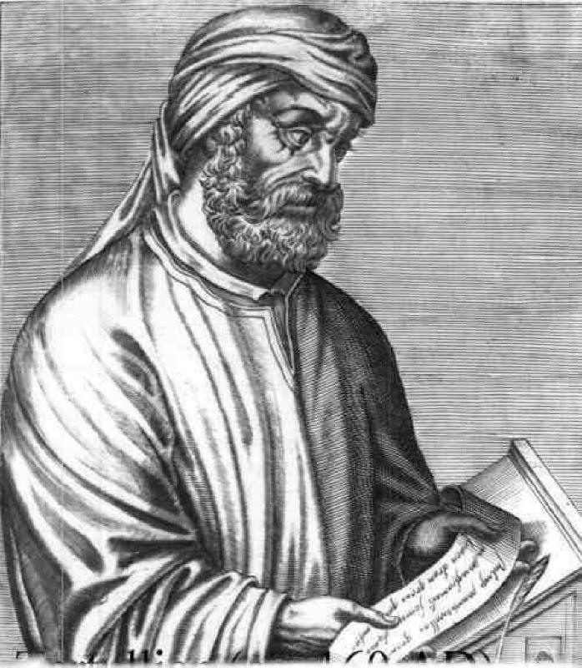
Tertullian of Carthage c. 160 - c. 230
Born in Carthage, practiced law in Rome
Prolific apologist
First to write Christian Latin literature
Public Domain

Slide 53
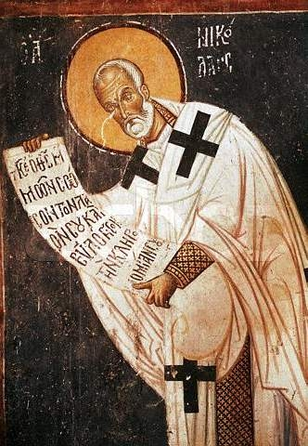
Origen of Alexandria c. 185 - 254
Studied Hebrew and dictated prolifically
Wrote commentaries on all books of the Bible
Refuted Celsus’ The True Word
vultuschristi.org

Slide 54
Eusebius of Caesarea c. 260 - c. 340
“Father of Church History”
Ecclesiastical History
History of the church until AD 324
Careful excerpts from original source material
Divided his NT into paragraphs and provided a synoptic table
Public Domain

Slide 55
Thallus Middle of 1st Century
Wrote about AD 52
Works only exist where quoted by others
Julius Africanus in AD 221 quotes from him in Chronography

Slide 56
Chronography 18.1
“On the whole world there pressed a most fearful darkness, and the rocks were rent by an earthquake, and many places in Judea and other districts were thrown down. This darkness Thallus, in the third book of his History, calls, as appears to me without reason, an eclipse of the sun.”
This occurred at the time of a full moon “it was at the season of the paschal full moon that Jesus died”

Slide 57
Josephus c. 35 - c. 100
Pharisee of the priestly line
Jewish historian working under Roman authority after his capture and prediction of Vespasian’s rule
Wrote Jewish Wars AD 75 and Antiquities of the Jews AD 94
Public Domain

Slide 58
Jewish Antiquities 20.9.1
“But the king deprived Joseph of the high priesthood, and bestowed the succession to that dignity on the son of Ananus, who was also himself called Ananus….so he assembled the Sanhedrin of judges, and brought before them the brother of Jesus, who was called Christ, whose name was James, and some others; and when he had formed an accusation against them as breakers of the law, he delivered them to be stoned.”

Slide 59
Jewish Antiquities 18.3.3
“Jesus, a wise man”
“ for he was a doer of wonderful works”
“a teacher of such men as receive the truth”
“He drew over to him both many of the Jews and many of the Gentiles.”

Slide 60
Jewish Antiquities 18.3.3
“Pilate, at the suggestions of the principal men among us, had condemned him to the cross”
“Those that loved him at the first did not forsake him”
“ And the tribe of Christians, so named from him, are not extinct at this day.”

Slide 61
Cornelius Tacitus c. 55-120
1st century Roman
Considered one of the more accurate historians of the ancient world
Ab exesssu divi Augusti (Annals) AD 117
Clipart.com

Slide 62
The Annals
“Nero fastened the guilt and inflicted the most exquisite tortures on a class hated for their abominations, called Christians by the populace. Christus, from whom the name had its origin, suffered the extreme penalty during the reign of Tiberius at the hands of one of our procurators, Pontius Pilatus, and a most mischievous superstition, thus checked for the moment, again broke out not only in Judaea, the first source of the evil, but even in Rome”

Slide 63
The Annals
“Mockery of every sort was added to their deaths. Covered with the skins of beasts, they were torn by dogs and perished, or were nailed to crosses, or were doomed to the flames and burnt, to serve as a nightly illumination, when daylight had expired…Hence, even for criminals who deserved extreme and exemplary punishment, there arose a feeling of compassion; for it was not, as it seemed, for the public good, but to glut one man's cruelty, that they were being destroyed.”

Slide 64
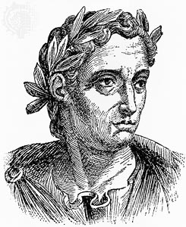
Pliny the Younger 63 – c. 113
Lawyer and magistrate
Served as the imperial governor of Bithynia from AD 110
Wrote to Emperor Trajan and received reply on how to deal with Christians
classicalanthology.theclassicslibrary.com

Slide 65
Epistulae X.96
“They were in the habit of meeting on a certain fixed day before it was light, when they sang in alternate verses a hymn to Christ, as to a god, and bound themselves by a solemn oath, not to do any wicked deeds, but never to commit any fraud, theft or adultery, never to falsity their word, nor deny a trust when they should be called upon to deliver it up; after which it was their custom to separate, and then reassemble to partake of food– but food of an ordinary and innocent kind.”

Slide 66
Epistulae X.96
“Never have been present at any trials of the Christians, I do not know what means and limits are to be observed in examining or punishing them... This is the way I have dealt with those who have been denounced to me as Christians: I asked them if they were Christians. If they admitted that they were, I asked them again a second and a third time threatening them with capital punishment. If they still persevered, I ordered them to be executed. For I felt certain that whatever it was that they professed, their contumacy and inflexible obstinacy obviously demanded punishment. There were others of like madness, but since they were Roman citizens, I had them sent to Rome.....”

Slide 67
Epistulae X.97
Emperor Trajan’s reply
“No search should be made for these people, when they are denounced and found guilty they must be punished, with the restriction, however, that when the party denies himself to be a Christian, and shall give proof that he is not (that is, by adoring our gods) he shall be pardoned on the round of repentance even though he may have formerly incurred suspicion.”

Slide 68
Suetonius c. 70 - c. 130
An equestrian and historian
De Vita Caesarum (The Twelve Caesars) AD 119 is his most important surviving work
Close friend of Pliny the Younger
Public Domain

Slide 69
Life of Claudius 25.4
“As the Jews were making constant disturbances at the instigation of Chrestus, he expelled them from Rome.”

Slide 70
Life of Nero 16
“Punishment was inflicted on the Christians, a body of people addicted to a novel and mischievous superstition.”

Slide 71
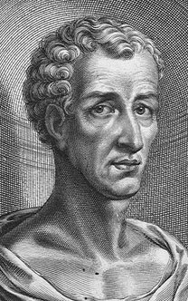
Lucian of Samosata c. 125 – c. 200
2nd Century Assyrian rhetorician and satirist who wrote in Greek
Wrote the Passing of Peregrinus, in which the lead character Peregrinus Proteus takes advantage of the generosity and gullibility of Christians
Public Domain

Slide 72
Death of Pelegrine
“The Christians, you know, worship a man to this day– the distinguished personage who introduced their novel rites, and was crucified on that account… You see, these misguided creatures start with the general conviction that they are immortal for all time, which explains the contempt of death and voluntary self-devotion which are so common among them; “

Slide 73
Death of Pelegrine continued
“And then it was impressed on them by their original lawgiver that they are all brothers, from the moment that they are converted, and deny the gods of Greece, and worship the crucified sage, and live after his laws. All this they take quite on faith, with the result that they despise all worldly goods alike, regarding them merely as common property.”

Slide 74
Celsus 2nd Century
Greek Philosopher
Opponent of Christianity
His work "The True Word“ is lost, but most is preserved word for word in a refutation by Origen

Slide 75
The True Word
Claims
Jesus was born of adultery
He was the illegitimate son of a Roman Soldier names panthera (parthenos means virgin)
His divine claims were disproved by his poverty and his miserable end.

Slide 76
Mara Bar-Serapion 1st to late 3rd Century
Stoic philosopher from ancient Syria
Author of the Letter of Mara bar Serapion
Public Domain

Slide 77
Letter of Mara bar Serapion
“What advantage did the Athenians gain from putting Socrates to death? Famine and plague came upon them as a judgment for their crime. What advantage did the men of Samos gain from burning Pythagoras? In a moment their land was covered with sand. What advantage did the Jews gain from executing their wise king? It was just after that that their kingdom was abolished. God justly avenged these three wise men:… the Jews, ruined and driven from their land, live in complete dispersion. ..Nor did the wise king die for good; he lived on in the teaching which he had given.”

Slide 78
Talmud
Record of rabbinical discussions
2 Components
Mishnah (Compendium of oral law)
Gemara (Discussion of the Mishnah
2 Schools
Talmud Yerushalmi
Talmud Bavli
www.talmud.de

Slide 79
Peter Schäfer
“The rabbinic sources (again, particularly the Bavli) do not refer to some vague ideas about Jesus and Christianity but [instead] reveal knowledge—more often than not a precise knowledge– of the New Testament.”

Slide 80
Edwin Yamauchi
“What we have concerning Jesus actually is impressive…In all, at least forty-two authors, nine of them secular, mention Jesus within 150 years of his death.”

Slide 81
Edwin Yamauchi
“Even if we did not have the New Testament or Christian writings, we would be able to conclude from such non-Christian writings…that: (1) Jesus was a Jewish teacher; (2) many people believed that he performed healings and exorcisms; (3) he was rejected by the Jewish leaders; (4) he was crucified under Pontius Pilate in the reign of Tiberius; (5) despite this shameful death, his followers, who believed that he was still alive, spread beyond Palestine so that there were multitudes of them in Rome by A. D. 64; (6) all kinds of people from the cities and countryside—men and women, slave and free—worshipped him as God by the beginning of the second century.”

Slide 82
Bruce Metzger
“The early non-Christian testimonies concerning Jesus, though scanty, are sufficient to prove (even without taking into account the evidence contained in the New Testament) that he was a historical figure who lived in Palestine in the early years of the first century, and that he gathered a group of followers about himself, and that he was condemned to death under Pontius Pilate. Today no competent scholar denies the historicity of Jesus.”

Slide 83
Gary Habermas
“We should realize that it is quite extraordinary that we could provide a broad outline of most of the major facts of Jesus’ life from ‘secular’ history alone. Such is surely significant.”

